Slide 1
Requirement Gathering Report for a Car Fault Diagnoses Mobile App
By group 2

Slide 2
Contents
Group 2
Introduction
Stakeholders
Methods of Requirement Gathering
Tools used
Results
Data Cleaning
User Reluctance Assessment
Conclusion

Slide 3
Introduction
Group 2
To assist car owners with dashboard
To develop a reliable and user-friendly mobile application for car fault diagnosis

Slide 4

Stakeholders
Group 2
1
Primary Users
2
Secondary Users
3
Data Providers
4
Project Team
5
Academic Supervisor

Slide 5
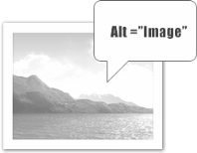
Methods of Requirement Gathering
Group 2
To effectively collect user needs and expectations, the following methods were employed:
1
Interviews
2
Online Survey
3
Observations

Slide 6
Tools Used
Group 2
1
Google Forms
2
Whatsapp
3
Microsoft Word
4
Google Sheets

Slide 7
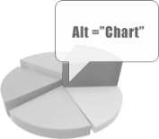
Survey Results and Summary
Group 2
Would Users use the App?
This show that 93.8% of the survey respondents would find a mobile app useful for diagnosing dashboard warning lights and engine sounds

Slide 8
Survey Results and Summary
Group 2
Challenges Faced By Car Owners
1
Don’t know the meaning of warning lights
2
Cost of Repairs
3
Lack of trust in Mechanics
4
Programs Disrupted
5
Difficulties to find Mechanics
6
Car won’t start

Slide 9
Survey Results and Summary
Group 2
Users Desired Features
1
Explanation of Faults
2
Step-by-step repair guides
3
Sound Analysis
4
Offline Access
5
Urgency Level
6
Camera-Based recognition

Slide 10
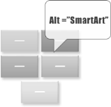
Summary of Results
Group 2
Responses from interviews Conducted
1
Mechanics
Different Car brands, they function and behave differently.
Different Dashboards & meanings, different warning Sounds
Car owners
Lack of Confidence in mechanics
Cost of Repair
Remote Areas with no idea where to find a mechanic
2

Slide 11

Suggestions from Responses
Group 2
1
Maintenance and Regular check Notifications
2
Nearby Mechanic Recommendations
3
Different dashboards for Popular car brands

Slide 12
Data Cleaning
Group 2
After collecting responses from surveys and interviews, we performed a basic data cleaning process to ensure accuracy and relevance.
Incomplete or Duplicate Surveys were removed
Open-ended entries were grouped into themes
Unrelated answers were filtered out

Slide 13
User Reluctance Assessment
Group 2
During our research, we identified a few users who expressed hesitation about using a car diagnostic app. Key concerns included:
Privacy
Accuracy
Over confidence

Slide 14
User Reluctance Assessment
Group 2
To address these concerns, we plan to implement:
Offline functionality
Clear accuracy information and disclaimers in the app
A simple, transparent interface with trusted sources for information

Slide 15
Conclusion
Group 2
Group 2
The End……. Thanks for Listening
→

